Slide 1
Introduction to
SQLPathFinder
(view in slide show mode)
Intel Confidential
Notes:
1

Slide 2
This presentation provides an introduction to SQLPathFinder, and explains the importance of Keys .

Slide 3
Agenda
SQLPathFinder Overview
The Importance of Keys

Slide 4
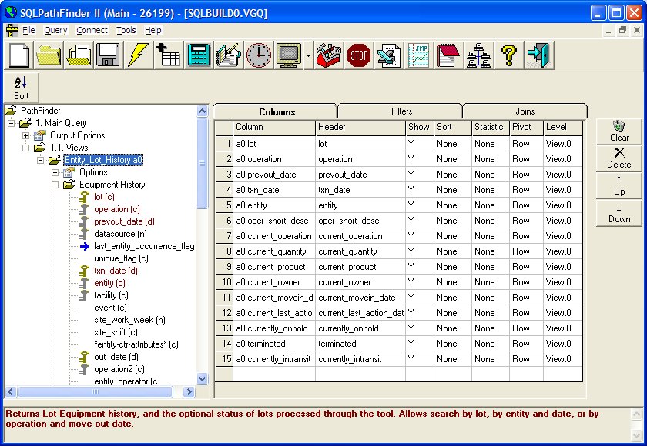

SQLPathFinder Overview
This graphic provides a high-level overview of SQLPathFinder.
EAM
EAM
SQLPathFinder
Install &
Update Share
SQL
Script
ScriptHost
Extract
Engine
App or User
Meta Data
MARS, ARIES, OASys, MIDAS, YAS, SPEED,
TCA, SIGAC, Hadoop …
EAM

Slide 5
Intro to SQLPathFinder
The "Install & Update Share" icon serves as a reminder to update SQLPathFinder regularly, preferably weekly. Product updates are stored on a file share and when you run an update, your local SQLPathFinder directory is updated with the latest database definitions and software.
EAM
EAM
SQLPathFinder
Install &
Update Share
SQL
Script
ScriptHost
Extract
Engine
App or User
Meta Data
MARS, ARIES, OASys, MIDAS, YAS, SPEED,
TCA, SIGAC, Hadoop …
EAM

Slide 6
Intro to SQLPathFinder
You use the SQLPathFinder interface to design a query involving one or more datasources. SQLPathFinder then generates a script which you can run against databases that you have access rights to, and direct your output to Excel or JMP. Most database permissions are obtained from the Enterprise Access Management system (EAM).
EAM
EAM
SQLPathFinder
Install &
Update Share
SQL
Script
ScriptHost
Extract
Engine
App or User
Meta Data
MARS, ARIES, OASys, MIDAS, YAS, SPEED,
TCA, SIGAC, Hadoop …
EAM

Slide 7
Intro to SQLPathFinder
EAM
EAM
SQLPathFinder
Install &
Update Share
SQL
Script
ScriptHost
Extract
Engine
App or User
Meta Data
The SQLPathFinder Security section on the product web page describes how you can request access to different databases.
MARS, ARIES, OASys, MIDAS, YAS, SPEED,
TCA, SIGAC, Hadoop …
EAM

Slide 8
Intro to SQLPathFinder
EAM
EAM
SQLPathFinder
Install &
Update Share
SQL
Script
ScriptHost
Extract
Engine
SQLPathFinder also interacts with an environment called ScriptHost to let you schedule jobs. ScriptHost requires separate EAM permissions, as also described on the Security page
App or User
Meta Data
MARS, ARIES, OASys, MIDAS, YAS, SPEED,
TCA, SIGAC, Hadoop …
EAM

Slide 9
Intro to SQLPathFinder
EAM
EAM
SQLPathFinder
Install &
Update Share
SQL
Script
ScriptHost
Extract
Engine
App or User
Meta Data
An advantage of ScriptHost is that queries are run on more powerful servers, and can be scheduled to run while your laptop is off.
MARS, ARIES, OASys, MIDAS, YAS, SPEED,
TCA, SIGAC, Hadoop …
EAM

Slide 10
Agenda
SQLPathFinder Overview
The Importance of Keys

Slide 11
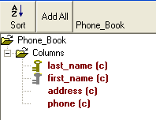
Importance of Keys
Shown here is a fictitious example of a Phone Book data source as SQLPathFinder would show it. The phone book data source contains columns last name, first name, address, & phone number. Note the key icons next to some columns.
Key (Index)
LAST_NAME
FIRST_NAME
ADDRESS
PHONE
CHONG
RICHARD
123 PEACE AVENUE...
123-4567
STEVENS
AMELIA
456 WORLD CENTER...
995-1995
YAZDANI
VAHID
789 KINGS STREET...
555-1234

Slide 12
Importance of Keys
Certain columns in a datasource are identified as keys which help speed up queries. E.g., column combination Last Name & First Name make up a key in a phonebook. Consecutive key columns are actually part of one multi-column key. If you forgot a person’s name & you searched a hardcopy phone book by their Address, the query would take longer than if you searched by their name.
Key (Index)
LAST_NAME
FIRST_NAME
ADDRESS
PHONE
CHONG
RICHARD
123 PEACE AVENUE...
123-4567
STEVENS
AMELIA
456 WORLD CENTER...
995-1995
YAZDANI
VAHID
789 KINGS STREET...
555-1234

Slide 13
Importance of Keys
Note the difference in how keys are represented. Last Name is marked with a gold key while First Name is marked with a silver key. Searching on gold key columns provides a performance advantage, whereas searching on silver key columns by themselves is of limited benefit. It is like searching a phone book by first name & address. You still have to search all rows in the book to find your data. However, searching by last name & first name provides the best performance.
Key (Index)
LAST_NAME
FIRST_NAME
ADDRESS
PHONE
CHONG
RICHARD
123 PEACE AVENUE...
123-4567
STEVENS
AMELIA
456 WORLD CENTER...
995-1995
YAZDANI
VAHID
789 KINGS STREET...
555-1234

Slide 14
Final Quiz!
Following are a few questions on the use of keys. You are allowed several chances to answer a question correctly. So relax and have fun! ☺
Intel Confidential

Slide 15
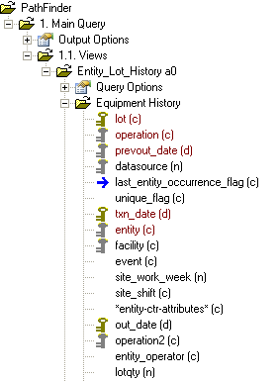
Quiz
This image shows keys in view Entity_Lot_History . The view contains three keys:
  Lot, Operation, PrevOut_Date, & DataSource, with Lot as the gold key
  Txn_Date, Entity, & Facility, with Txn_Date as the Gold key
  Out_Date & Operation2, with Out_date as the Gold Key
1
2
3

Slide 16
Quiz
Question 1
If you wanted to search by a list of entities and a date range, which filter columns would provide the best performance?
Out_Date and Entity
PrevOut_Date and Entity
Txn_Date and Entity
None of the above

Slide 17
Quiz
Question 2
If you wanted to search by a list of operations and a date range, which filter columns would provide the best performance?
Out_Date and Operation
Txn_Date and Operation
Out_Date and Operation2
All of the above would perform equally

Slide 18
Quiz
Question 3
If you wanted to search by a lot list and an Operation, which filter columns would provide the best performance?
Lot and Operation
Lot and Operation2
All of the above would perform equally

Slide 19
That concludes the presentation
Intel Confidential

